Slide 1
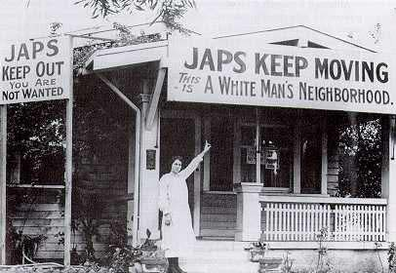
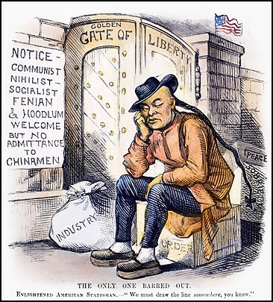
History of Immigration Law in the United States: Chinese Exclusion and Restrictive Legislation
Artemus Ward
Dept. of Political Science - Northern Illinois University
aeward@niu.edu
Bill of Rights Institute

Slide 2
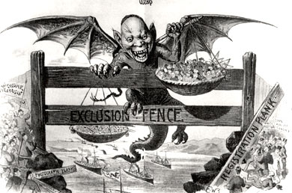
Introduction
America’s immigration history was marked by a decided transition at the end of the 19th Century from a state with essentially open borders for all to a nation of restrictions and closed borders for “undesirables.”
It is a political story of legislation conceived in ignorance and falsely presented to the public that resulted in unintended consequences.
Chinese immigrants were excluded at the end of the 19th Century and ushered in a succession of closed door policies for certain kinds of immigrants into the 20th Century.
These exclusion policies were followed by restrictive statutes and administrative actions that shrank numerical limits for those immigrants who had not otherwise been excluded.
By the time of WWII and the Cold War, the U.S. began reconsidering its restrictive stance and ultimately rejected it in favor of a more liberal immigration policy.

Slide 3
U.S. Supreme Court Weighs In
Throughout the American period of essentially open borders, the U.S. Supreme Court reflected the transition from state authority over immigration to federal responsibility.
In New York v. Miln (1837) the Supreme Court affirmed the authority of state governments to set criteria for the admission of immigrants and to reject those who did not fit those standards.
But in the Passenger Cases (1849) the Court reversed itself finding that state laws imposing taxes on immigrants infringed on the power of Congress to regulate commerce with foreign nations.
In Henderson v. Mayor of New York (1875) the Court held that all immigration laws of seaboard states were unconstitutional because they usurped the exclusive power of congress to regulate foreign commerce.
In response, states abolished their immigration commissions and port authorities. The entire burden of orienting foreigners and turning away the incapacitated fell to private, philanthropic organizations.
By the 1880s, more than half a million immigrants were arriving at U.S. ports each year. Their resources stretched thin, charities lobbied the federal government to take over.

Slide 4
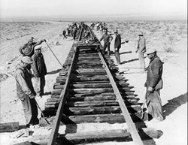
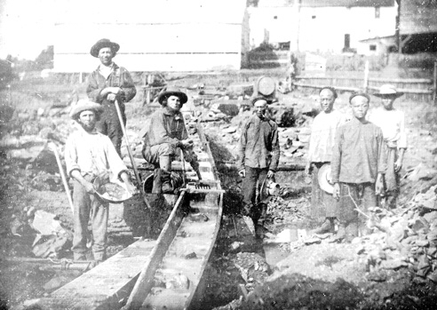
Asians
Immigrants of Asian descent began arriving in the mid-19th Century after news of gold strikes in California reached China.
Almost all came from the area around Canton and were young men seeking "riches": consular reports indicated that for many the goal was to return with $400 and that by mid-decade some had already achieved it. In the tradition of previous Chinese migrants within Asia, they called themselves "guests": since the Chinese characters for California also mean "gold mountain," those in California were "gan sam hack" or gold mountain guests.
But their numbers did not become significant until after the Civil War. They worked building the Central Pacific Railroad, or as miners, cooks, farmers, launderers, merchants, and restaurant owners. One thousand Chinese were sent to the South to work on railroads, further fueling a national backlash against them.

Slide 5
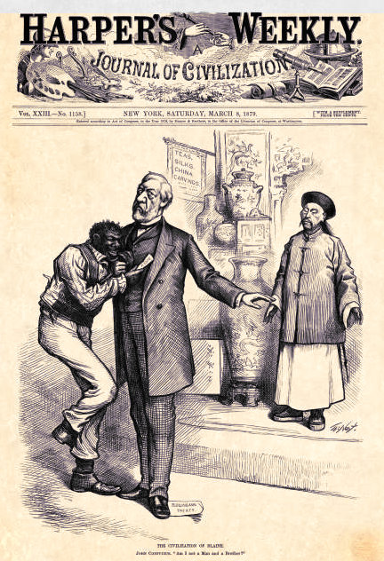
Burlingame-Seward Treaty (1868)
The treaty granted China “most favored nation” status for trade, included measures that promised the Chinese the right to free immigration and travel within the United States, and allowed for the protection of Chinese citizens in the United States in accordance with the most-favored-nation principle. Another article gave the citizens of the two nations reciprocal access to education and schooling when living in the other country.
All of these articles served to reinforce the principle of equality between the two nations.
A number of Asians were naturalized in the middle decades of the nineteenth century, at least one of them at the behest of the federal government.
But politicians capitalized on anti-Chinese bias in the electorate including Republican James G. Blaine who is pictured as the benevolent protector of grateful African Americans by trampling on the treaty. Caption: “The Civilization of Blaine. John Confucius. ‘Am I not a man and a brother?’” Harper’s Weekly, March 8, 1879, cover.

Slide 6
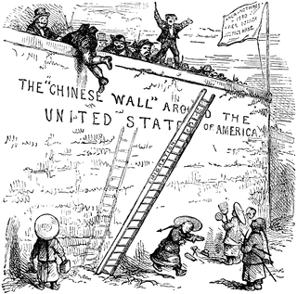
Chinese Immigration: Backlash
No variety of anti-European sentiment has ever approached the violent extremes to which anti-Chinese agitation went in the 1870’s and 1880’s.
Many white workers feared the Chinese would compete with and lower the wages of American workers. By the end of the 1870s, 15,000 men were out of work in San Francisco alone, adding to the white labor agitation. The Chinese immigrant was made to be the scapegoat.
It was easier to justify the violence, the driving out, the boycotts and mistreatment of the Chinese when they could be turned into something less than human. Thus, a dehumanizing form of racism (long practiced against African-Americans) was employed against the Chinese and ultimately all Asian immigrants.
In addition to physical violence, anti-immigrant brutality was evident in legislation, land policy, and labor practices.

Slide 7
Page Act (1875)
In his 1874 annual message, President Ulysses S. Grant weighed in against the Chinese, claiming that the "great proportion" of Chinese were involuntary contract laborers--and thus illegal immigrants--and that an even worse evil were Chinese women, almost none of whom "perform any honorable labor, but ... are brought for shameful purposes." He went on to say that "if this evil practice can be legislated against" it would be his "pleasure" to enforce it.
The next year, Congress passed the so-called Page Act. It created two classes of illegal immigrants--persons under sentence for crimes other than political and women "imported for purposes of prostitution" and made the importation of "any subject of China, Japan, or any Oriental country" without their consent a felony. Rhetorical sections of the statute and remarks made during the congressional debate made it clear that the bill was really aimed at Chinese women. Recent scholarship focusing on the act's administration has shown that it was, in fact, an effective inhibition on the immigration of Chinese women.
The same Congress that passed the Page Act also authorized a joint congressional committee to investigate Chinese immigration; this took testimony in the Palace Hotel in San Francisco just before and after the presidential election of 1876. By that time both national political party platforms inveighed against the Chinese, the Republicans a little tentatively--it is "the immediate duty of Congress to investigate the effects of the immigration and importation of Mongolians"--while the Democrats unreservedly denounced "the policy which tolerates the revival of the coolie-trade in Mongolian women held for immoral purposes, and Mongolian men to perform servile labor."

Slide 8
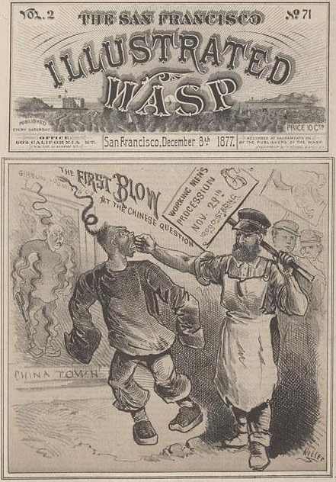
“The First Blow at the Chinese Question” (1877)
A sturdy-looking white man wearing a trade apron, and two other laborers behind him have entered Chinatown. They encounter a Chinese man on the sidewalk. In one hand, the lead worker carries a sign, “Working Men’s Procession.” With his right arm, the lead workingman lands a punch directly into the face of the Chinese immigrant. The blow knocks his victim off balance. The Chinese man’s long queue spirals outward from the impact. His oversized tunic extends past his arms, covering his hands. The Chinese man does not curl his fists to strike back.
Another Chinese immigrant stands behind a storefront door or window and reacts in horror. He is distorted and ethereal. His whole body is aquiver, as if he is being vaporized, like a genie returning to a lamp. His fluid contours suggest he is fading away. This second Chinese figure is startled and his queue reacts in the same manner as the man under attack. He holds a gun by his side, but he makes no attempt to raise the weapon in defense. He is unable to protect his territory, his placement inside the rectangular border limits his power. The frame suggests he is reduced to one dimension, a poster or piece of wall art.
At the time, it was fashionable for Americans to collect Chinese art, but acceptable to exclude the Chinese people. The image suggests that the Chinese belong on walls, but not in the streets.

Slide 9
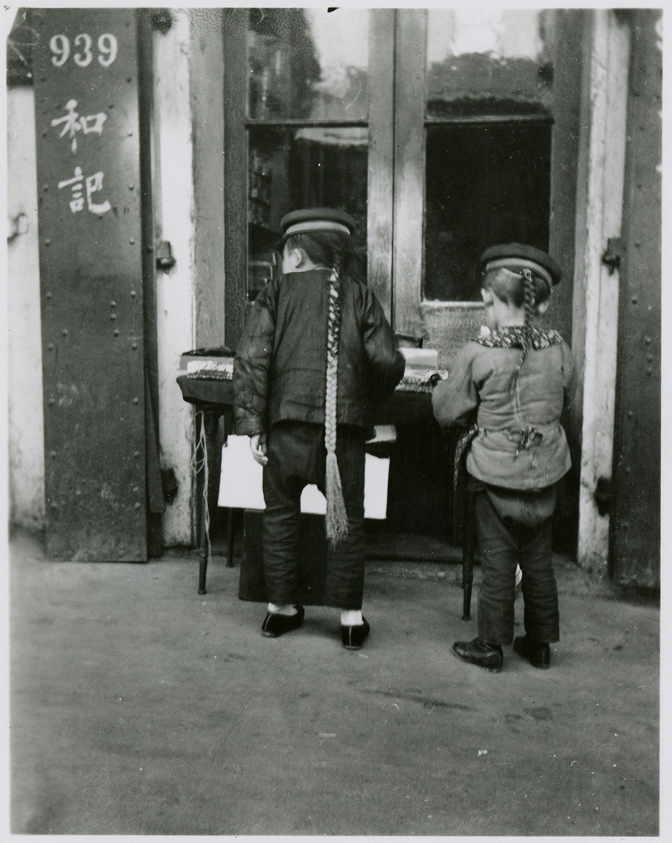
Pigtail Ordinance (1878)
During the Qing Dynasty, it was considered treason for Chinese men to fail to wear their hair in a queue.
Officials in San Francisco believed that the threat of losing their queues would keep Chinese immigrants from overcrowding the jails.
They passed a law known as the “Pigtail Ordinance,” which forced prisoners to submit to having their hair cut within an inch of their scalp. Although the law applied to all prisoners, the ponytails worn by the Chinese were symbols of identity. The loss of one’s queue was considered a mark of disgrace. According to their beliefs, cutting it caused great suffering after death.
After a sheriff “wantonly, maliciously” cut off his queue, a Chinese immigrant named Ho Ah Kow took him to court. The judge invalidated the San Francisco “Pigtail Ordinance” on equal protection grounds—granting a historic victory for Chinese Americans.
After the fall of the Qing Dynasty in 1912, the hairstyle was no longer required, and few continued the practice.

Slide 10
Fifteen Passenger Bill (1878)
The majority report of the joint congressional committee claimed that the Pacific Coast had to become "either American or Mongolian," and insisting that there was "not sufficient brain capacity in the Chinese race to furnish motive power for self-government" and that "there is no Aryan or European race which is not far superior to the Chinese." It urged the president to get the Burlingame Treaty modified and Congress to legislate against "Asiatic immigration."
The report was presented to Congress while it was settling the disputed election of 1876, so no immediate action was taken. After much debate the next session of Congress, just before it went out of existence, passed the so-called fifteen passenger bill which barred any vessel from bringing more than fifteen Chinese immigrants. A sticking point was the existing Burlingame Treaty, which some wanted to override totally while others wanted to wait for a diplomatic renegotiation. The bill also instructed the president to notify the Chinese that portions of the treaty were abrogated, which passage of the bill would have accomplished.
Rutherford B. Hayes responded with a reasoned veto message that accepted the desirability of stemming Chinese immigration. He argued that the Chinese manifested "all the traits of race, religion, manners, and customs, habitations, mode of life, segregation here, and the keeping up of the ties of their original home ... [which] stamp them as strangers and sojourners, and not as incorporated elements of our national life." But, he insisted, there was no emergency to justify unilateral abrogation of the treaty, which could have disastrous consequences both for American merchants and for missionaries in China. He promised that there would be a renegotiation of the treaty.

Slide 11
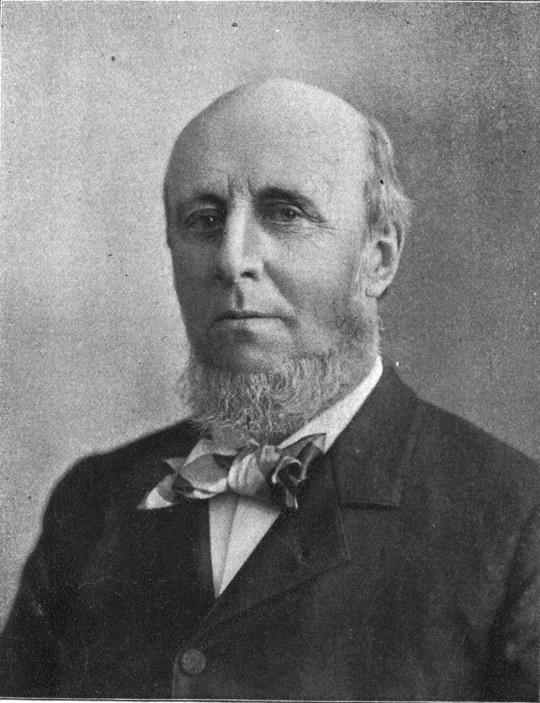
Angell Treaty (1881)
According to the new treaty, the United States government would temporarily suspend immigration of skilled and unskilled laborers from China, while still allowing the immigration of white-collar professionals. The treaty also reaffirmed the United States' continuing commitment to protect the rights and privileges of Chinese laborers already present in the United States.
The prefix stated: "The United States, because of the constantly increasing immigration of Chinese labourers to the territory of the United States and the embarrassments consequent upon such immigration now desires to negotiate a modification of the existing Treaties which shall not be in direct contravention to their spirit."
James Burrill Angell negotiated
the treaty for the U.S.

Slide 12
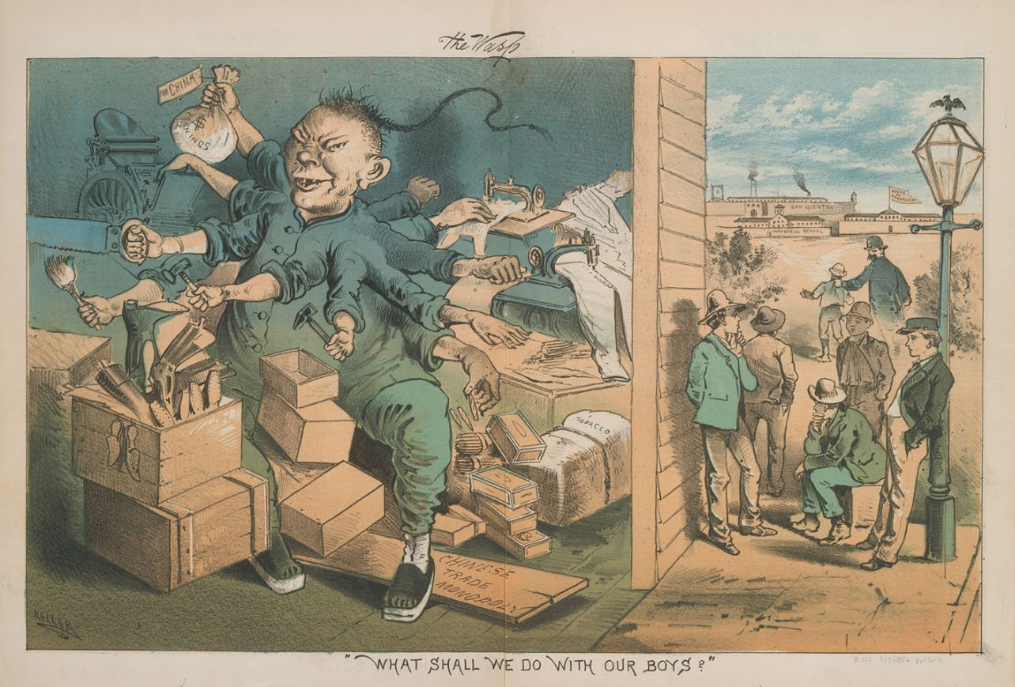
“What Shall We Do With Our Boys” – 3 March 1882 by George Frederick Keller for The San Francisco Illustrated Wasp

Slide 13
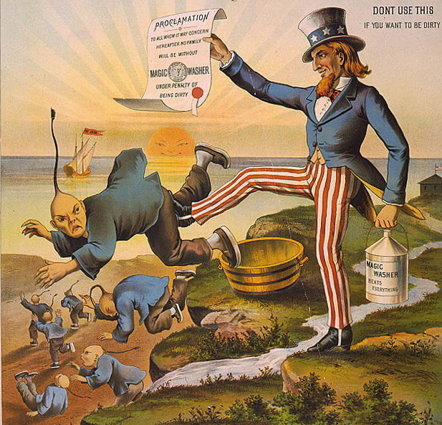
Chinese Exclusion Act (1882)
Congress passed the Chinese Exclusion Act in response to a vocal anti-Chinese organized labor movement in the western United States.
It was the first law in American history implemented to prevent a specific ethnic group from immigrating to the United States and ushered in an era of closed borders for many.
It restricted Chinese immigration for 10 years (after President Chester Arthur vetoed a 20-year ban) and prevented existing immigrants from enjoying the right to vote or becoming citizens.
Virtually all immigration from China stopped.
Furthermore, despite laws and treaties promising federal protection, lynchings, boycotts, and mass expulsions still harassed the Chinese who remained after the federal government yielded to the clamor for their exclusion in 1882.
The act was extended in 1892 and on a permanent basis beginning in 1902. But it was repealed in 1943. Why?

Slide 14
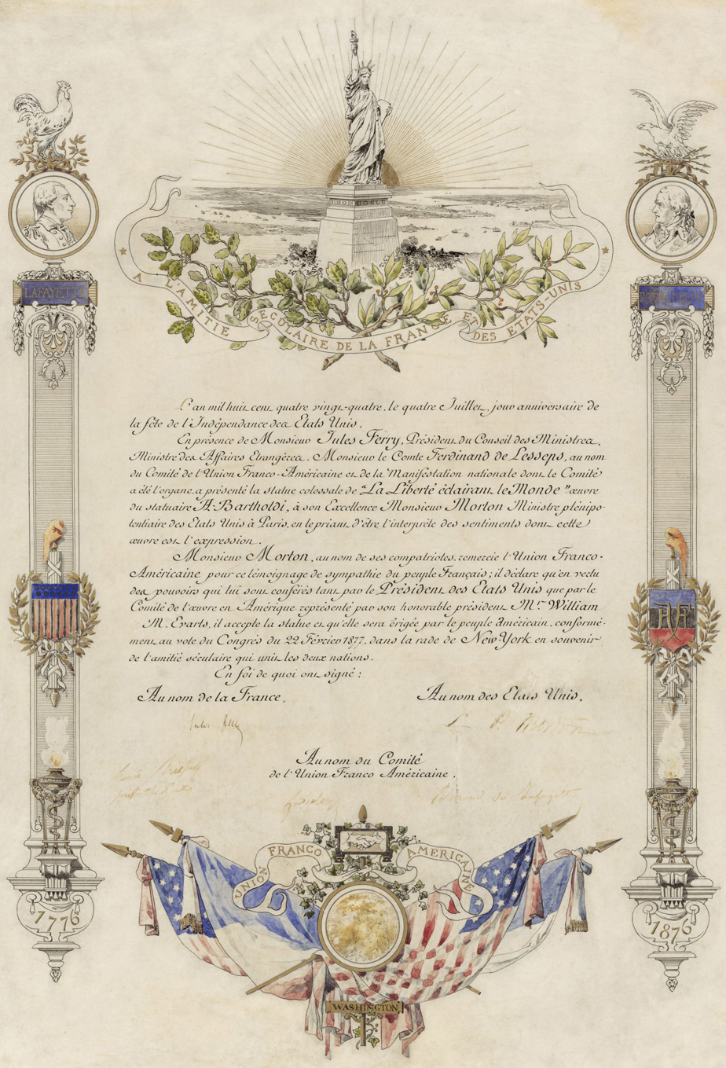
Statue of Liberty
(1884)
STATUE OF LIBERTY DEED OF GIFT, 1884:
"Liberty Enlightening the World" was a gift of friendship from France to the United States. At the statue's base, Emma Lazarus's poem "The New Colossus" speaks of the "huddled masses yearning to breathe free.“
While the Statue of Liberty symbolized America’s open-border history, the gift came as the nation shifted to closed-door policies for specific ethnic groups.
The statue was unveiled and dedicated in 1886.

Slide 15
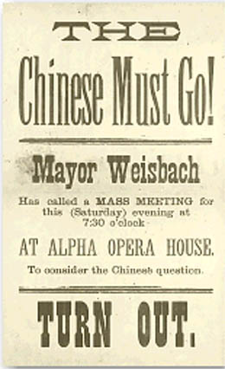
Tacoma Riot (1885)
During a wave of anti-Chinese violence in 1885 and 1886, white residents of the Territory of Washington became determined to clear the town of Tacoma of Chinese.
On November 3, 1885, a mob led by the mayor of Tacoma and reinforced by the Tacoma Police cleared Chinese shops and residences and marched their inhabitants to the railroad station.
One eyewitness, Lum May, recalled: ‘’There must have been in the neighborhood of 1000 people in the crowd of white people though I cannot tell how many. They went to all the Chinese houses and establishments and notiﬁed the Chinese to leave. Where the doors were locked they broke forcibly into the houses smashing in doors and breaking in windows. Some of the crowd was armed with pistols, some with clubs. They acted in a rude boisterous and threatening manner, dragging and kicking the Chinese out of their houses. My wife refused to go and some of the white persons dragged her out of the house. From the excitement, the fright and the losses we sustained through the riot she lost her reason and has ever since been hopelessly insane. She threatens to kill people with a hatchet or any other weapon she can get hold of. The outrages I and my family suffered at the hands of the mob has utterly ruined me. I make no claim, however, for my wife’s insanity or the anguish I have suffered. My wife was perfectly sane before the riot…. Mayor Weisbach appeared to be one of the leaders of the mob on the 3rd of November. I spoke to him and told him that Mr. Sprague had said the Chinese had a right to stay and would be protected. He answered me: ‘General Sprague has nothing to say. If he says anything we will hang him or kick him. You get out of here.’ I cried. He said I was a baby because I cried over the loss of my property. He said, ‘I told you before you must go, and I mean my word shall be kept good.’”
Numerous similar events took place across the American West. Fueled by an economic crisis, hostility against the Chinese mounted.
But the victims of these purges fought back, demanding the 14th Amendment rights that had been extended to Chinese immigrants through the Burlingame-Seward Treaty of 1868. They collectively filed 17 civil lawsuits against the U.S., claiming $103,365 in damages.
Hoping to revive trade talks with China, President Grover Cleveland pushed legislators to grant the demands of the Chinese victims of the Tacoma riot and their demands were ultimately met through congressional action.

Slide 16
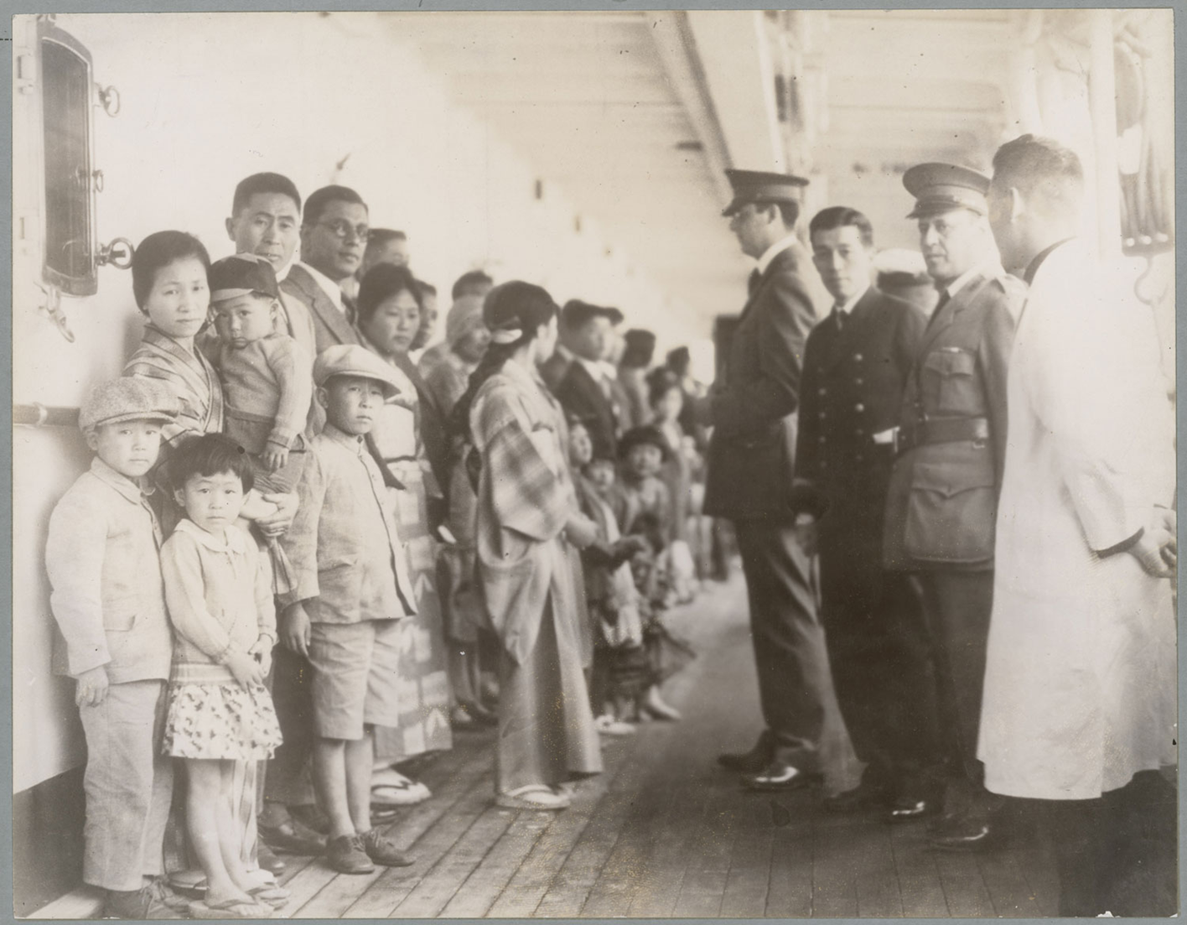
Scott Act (1888)
The Scott Act was passed in 1888 as an extension of the Chinese Exclusion Act.
Specifically, the Scott Act forbade Chinese immigrants who left the United States from returning.
The law’s effect was to strand an estimated 20,000-30,000 Chinese outside the U.S.
In Chae Chan Ping v. U.S. (1889), the U.S. Supreme Court upheld the Scott Act, despite the contradictory provisions of the Angell Treaty (1881).
Thus, the Court reaffirmed congressional authority over immigration and its ability to override treaties on the subject.

Slide 17
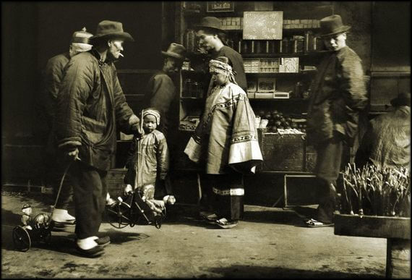
Bingham Ordinance (1890)
In 1890 San Francisco Supervisor Henry Bingham introduced a resolution to force residents into segregated neighborhoods. Believing Chinatown was “a cancer on the city,” and wanting to claim the prime real estate it occupied, the San Francisco Board of Supervisors passed the resolution with the Mayor’s approval.
The Bingham Ordinance, as it came to be known, required all Chinese living or working in the city to move their homes and businesses within 60 days to an area reserved for slaughterhouses and other “unhealthful” businesses.
Re Lee Sing was the first case to test the legality of the ordinance that would have displaced tens of thousands of Chinese. California Circuit Court Judge Sawyer struck down the law as a violation of the 14th Amendment.

Slide 18
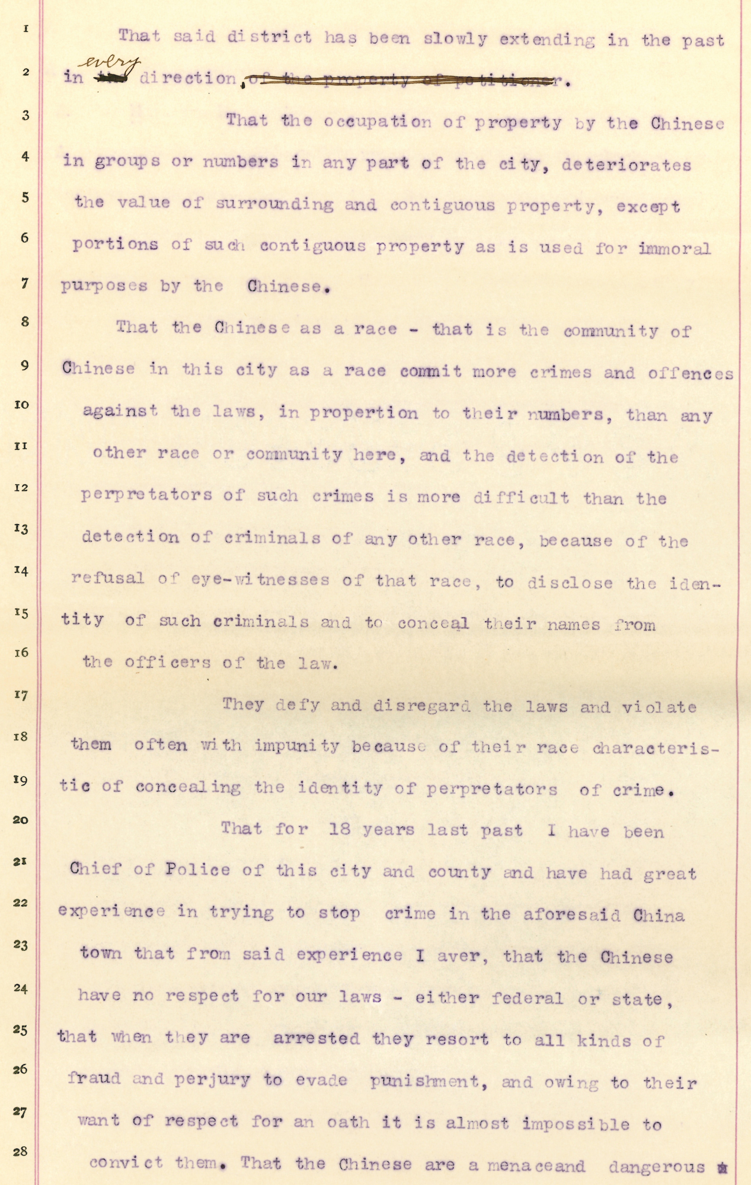
Police Chief Crowley’s Petition (1890)
In San Francisco Police Chief Crowley’s petition, he said, “the Chinese have no respect for our laws.” In fact, many Chinese respected and knew the laws well enough to use them to combat discrimination.
That the occupation of property by the Chinese in groups or numbers in any part of the city deteriorates the value of surrounding and contiguous property.
That the Chinese as a race – that is the community of Chinese in this city as a race commit more crimes and offences against the laws, in proportion to their numbers, than any other race or community here . . .
I aver, that the Chinese have no respect for our laws – either federal or state, that when they are arrested they resort to all kinds of fraud and perjury to evade punishment . . .
Their general habits, manners and customs are different from, and repugnant to those of the white and all other races, and as a race the Chinese assimilate with no other.
The Chinese as a race, and the community of Chinese in this city as a rule are vicious and immoral – and their criminal habits are injurious and dangerous to all young persons of other races of both sexes who come in contact with them.

Slide 19
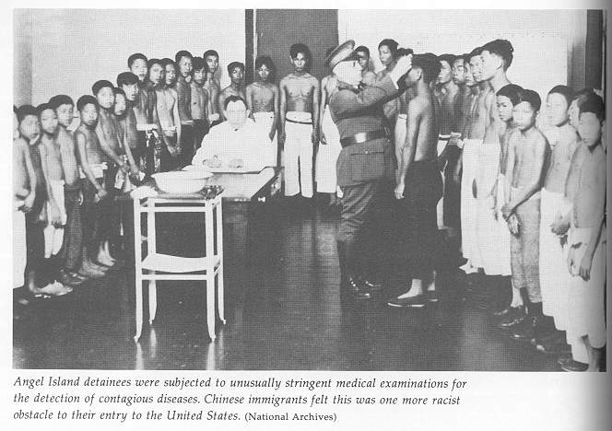
The Creation of a Federal Immigration Bureaucracy:
Immigration Act (1891)
In 1891 congress established the first federal administrative agency for the regulation of immigration: the Office of the Superintendent of Immigration within the Treasury Department.
It hired many Immigrant Inspectors who previously worked for state agencies. That meant a decided anti-Chinese bias among those working in the West. For example, while Ellis Island (1892) in New York facilitated European immigration (only 1% were rejected), Angel Island (1910) in San Francisco was established to isolate and impede Asian immigrants (18% were barred).
Thus the immigration bureaucracy developed unlike most other federal bureaucracies. While the Department of Agriculture spoke for farmers, the Department of Labor spoke for working people, and the Forest Service looked out for the trees, the immigration service, which became the Immigration and Naturalization Service (INS) in 1933, lobbied against the interests of legal immigrants, especially those of color and those who seemed to them un-American.

Slide 20
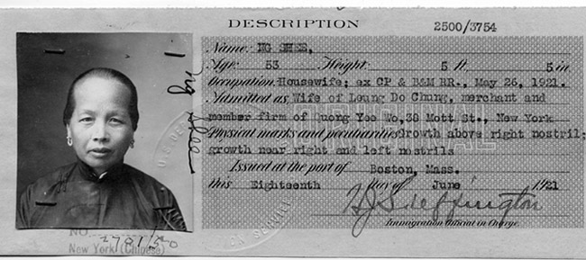
Geary Act (1892)
In 1892 congress renewed the Chinese exclusion for another ten years with the Geary Act.
The law also placed harsh and unprecedented restrictions upon Chinese persons living in the United States. Reversing the normal presumption, it stated that "any Chinese person or person of Chinese descent" was deemed to be in the country illegally unless he or she could demonstrate otherwise. It also denied the right of bail to Chinese aliens in habeas corpus proceedings, and required all Chinese in the United States to get a certificate of residence, a kind of internal passport, within a year or be deported.
The U.S. Supreme Court upheld the registration requirement in Fong Yue Ting v. U.S. (1893).
Over time, congress strengthened federal control over immigration, solidifying the end of the period of free and unlimited immigration by the early 20th Century.

Slide 21
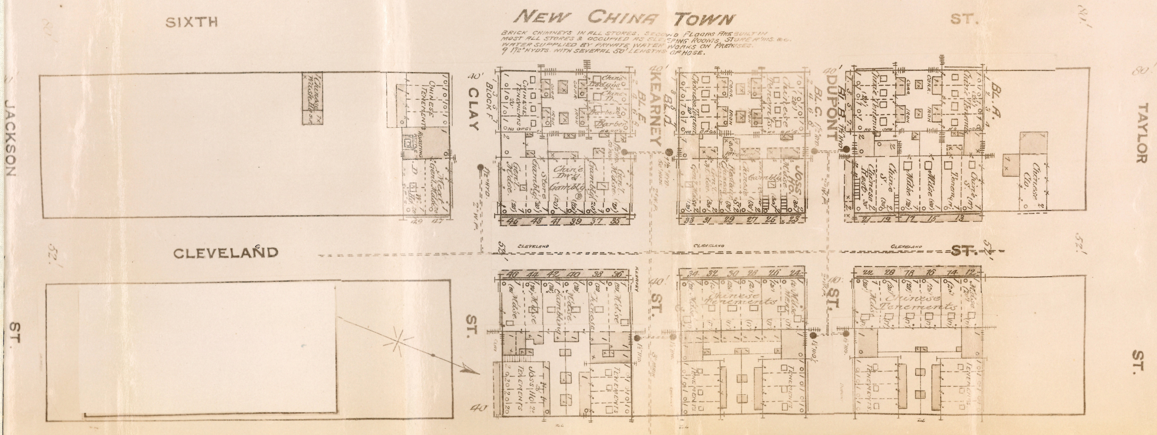
“The Chinese Must Go” (1894)
“The Chinese Must Go” was the slogan adopted in 1885 at California’s first statewide anti-Chinese convention.
To drive them away, Californians passed numerous local and state laws restricting the freedoms of the Chinese. They also terrorized, harassed, and attacked them.
But the Chinese refused to be driven out. They filed thousands of legal suits against discrimination, demonstrating their faith in the promise of equal justice in the United States.
Many times that faith was rewarded. One such case was Quen Hing Tong v. City of San Jose (1894). Quen Hing Tong, a Chinese merchant, asked the court to order the city to stop the police from harassing and intimidating him and his customers. This unprecedented lawsuit was a courageous stand against discrimination.
The residents of Chinatown in San Jose, California, rebuilt their neighborhood after arsonists burned it to the ground in 1883. Local authorities subsequently tried new tactics to force them out. A group of men claiming to be policemen began “terrorizing the tenants and driving away the customers.” This map was used as evidence in Quen Hing Tong’s successful lawsuit to stop the harassment.
Signaling the intention of the Chinese to remain in San Jose, “New China Town” was designed to protect its inhabitants and merchants from arson and other violence. Its buildings were made of brick, faced inward and were surrounded by a high picket fence covered with barbed wire. The gated streets were locked each night. But harassment and violence continued to drive away the residents and merchants.

Slide 22
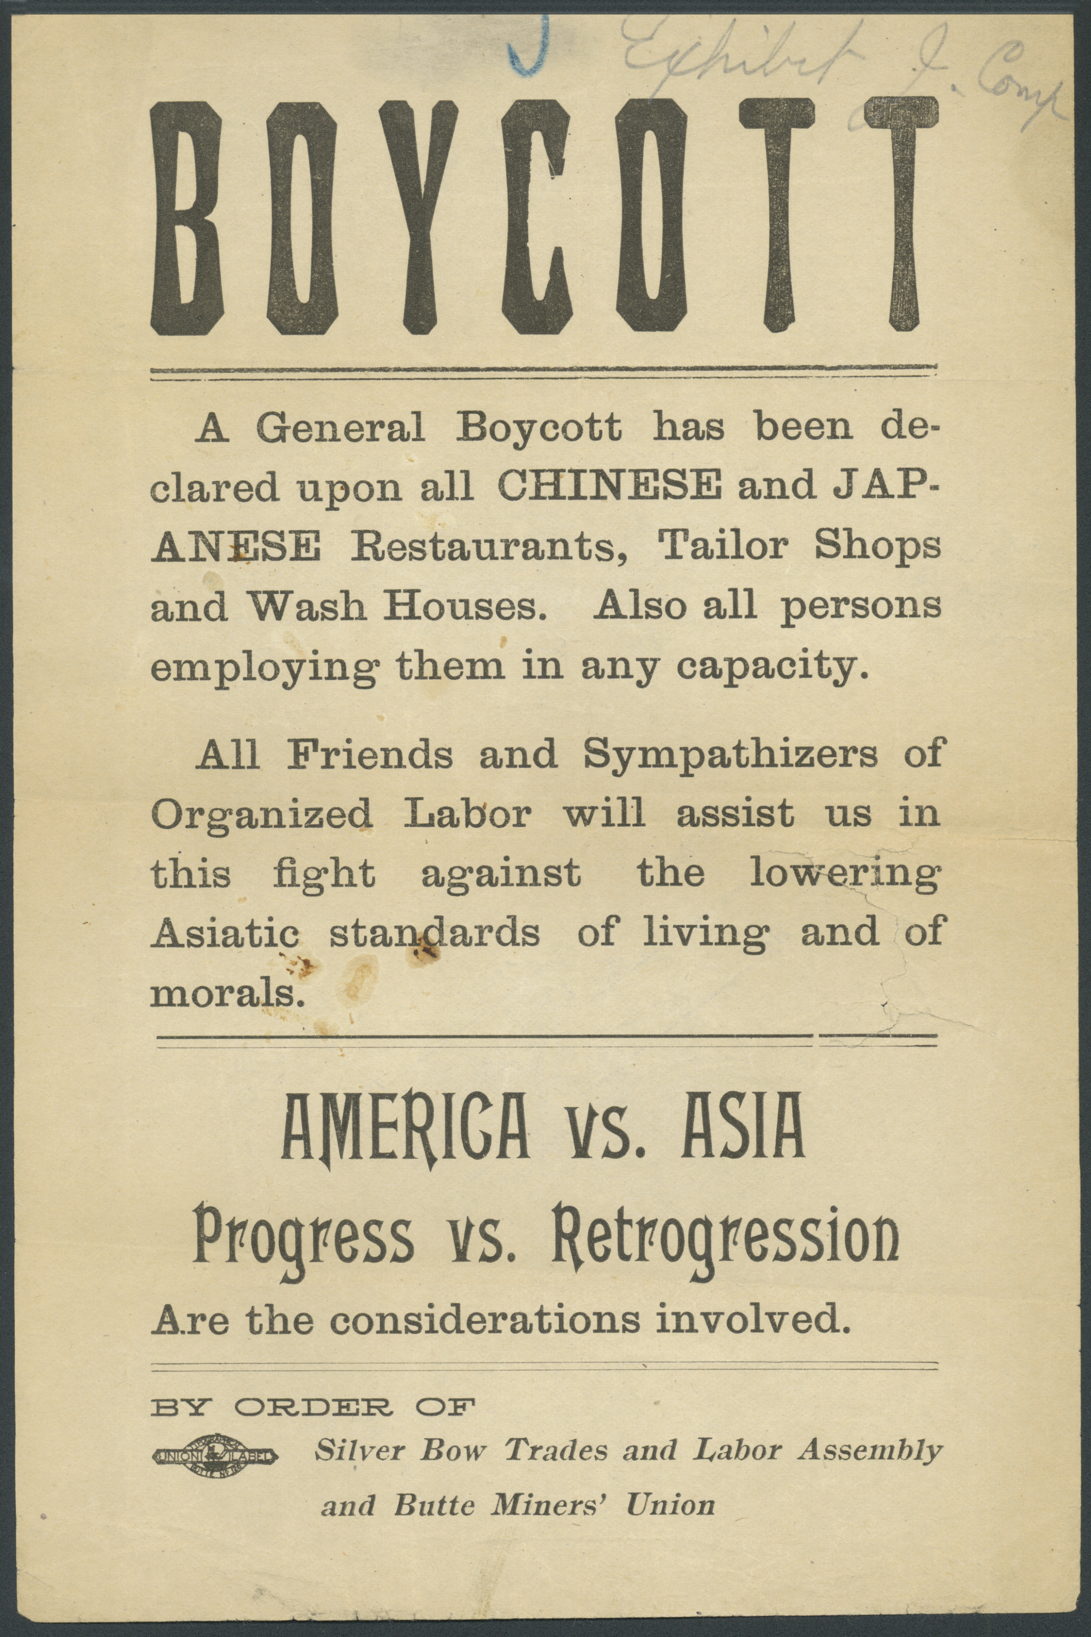
Anti-Asian Boycott (1898)
In 1898, labor unions in Butte, Montana, organized a boycott of Chinese-and Japanese-owned businesses and businesses that employed Asians.
Many Chinese fled Butte, but others challenged the boycott in Federal court.

Slide 23
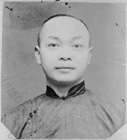
U.S. v. Wong Kim Ark (1898)
In 1898 the Supreme Court decision in United States v. Wong Kim Ark granted citizenship to an American-born child of Chinese parents who had a permanent domicile and residence in the United States, and who were there carrying on business, and are not employed in any diplomatic or official capacity under the Emperor of China.
All persons born in the United States since United States v. Wong Kim Ark have been granted citizenship although the Supreme Court has never explicitly ruled on the matter of children born to parents who are not legal residents of the United States.
Wong Kim Ark

Slide 24
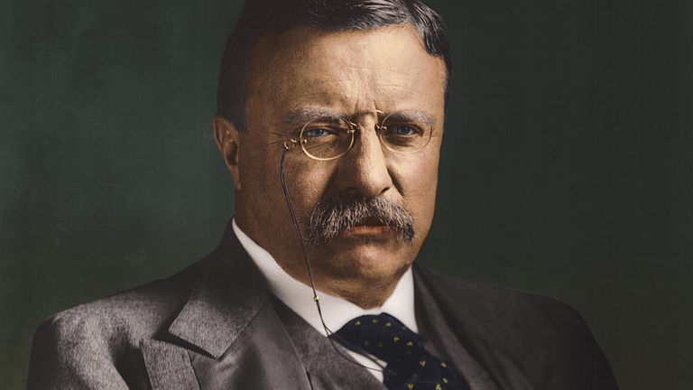
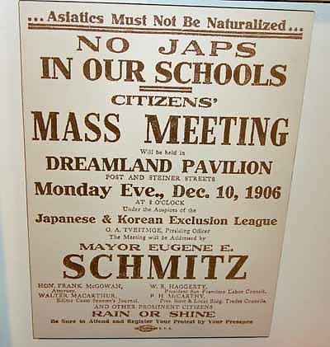
Japanese Restricted (1906)
In 1906, President Theodore Roosevelt made a “gentlemen’s agreement” with Japan that he would prevent segregation of Japanese students in west coast schools if Japan would restrict Japanese immigration to America.

Slide 25
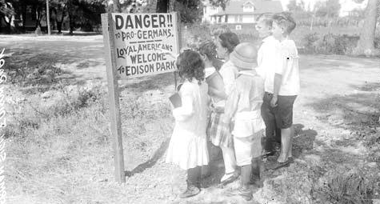
WWI Discrimination (1914-1918)
Germans faced significant discrimination during World War I. For example:
  German streets and towns were renamed.
  Public libraries withdrew German books from their shelves.
  The Red Cross barred individuals with German last names from joining in fear of sabotage.
  In Iowa the governor prohibited all foreign languages in schools and public places.
  Nebraska banned instruction in any language except English, but the U.S. Supreme Court ruled the ban unconstitutional in Meyer v. Nebraska (1923).
  German Americans chose to “Americanize” their names (e.g., Schmidt to Smith, Müller to Miller).
  In some cases Germans were physically attacked and even lynched.

Slide 26
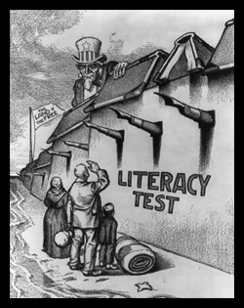
Immigration Act (1917)
Also known as the Literacy Act and Asiatic Barred Zone Act, the law defined a vast area of Asia from which no person could immigrate to the U.S.
The prohibited areas included most of the Middle East, South Asian countries like Persia and British-ruled India, as well as central Asia and Southeastern Asia.
For those immigrants who were not barred from immigrating under the act, literacy tests were imposed in order to exclude the mostly illiterate “new immigrants” from southeastern Europe.
The Act was the precursor to more restrictive legislation and exemplified how far the nation had come from the open border era.

Slide 27
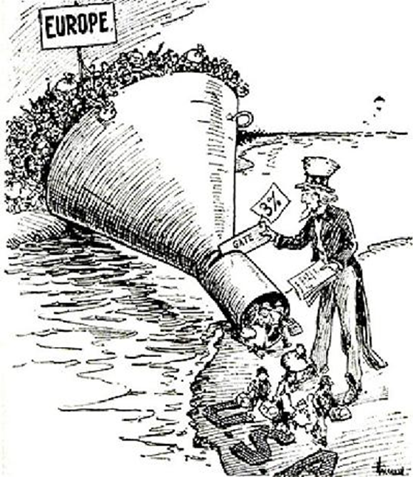
Emergency Quota Act (1921)
The Act placed limits on the number of people entering the country based on prescribed quotas.
The 1910 Federal Census was used to determine existing numbers of foreign-born citizens already living in the U.S. It then required that a number equivalent to only 3% of the already resident population from a certain country could be admitted.
This scheme became known as the National Origins Formula. Three years later, the policy would be greatly expanded.

Slide 28
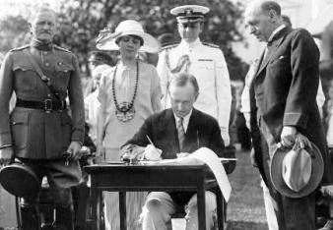
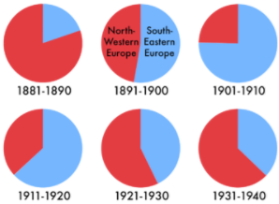
Immigration Act (1924)
By 1924 the restrictive climate reached its peak. In addition to the general backlash against old wave and Chinese immigrants, the eugenics movement, the post-WW I recession, and the Red Scare (1919–1921) fueled xenophobic fears of foreign radicals migrating to undermine American values and provoke an uprising like Russia’s 1917 Bolshevik Revolution.
In response, Congress passed the landmark Immigration Act (aka Johnson-Reed Act, including the National Origins Act and Asian Exclusion Act). It limited the annual number of immigrants who could be admitted from any country to 2% of the number of people from that country who were already living in the United States, based on the 1890 Census (as opposed to the 1910 Census the previous quota was based on).
The law was primarily aimed at further restricting immigration of Southern Europeans and Eastern Europeans, especially Italians and Eastern European Jews. The goal was to preserve the ethnic and cultural homogeneity of America as a nation descended from northwest Europe. Thus, in addition to the severe restrictions of southeastern Europeans, the law severely restricted the immigration of Africans and banned the immigration of Arabs and Asians. Interestingly there were no restrictions on people coming from the Americas.
Sen. David Reed, one of the Act’s principle sponsors, told the Senate that earlier legislation “disregards entirely those of us who are interested in keeping American stock up to the highest standard – that is, the people who were born here.”

Slide 29
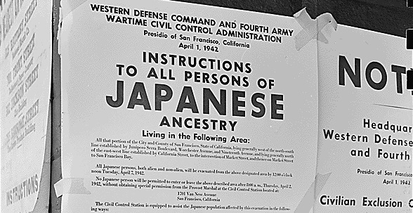
WWII Discrimination
(1936-1946)
Japanese immigrants were faced with the same kind of discrimination that other Asian immigrants—namely the Chinese—faced. However, the rise of Japan as a military power in the 1930s exacerbated nativist fears.
In the 1930s the Office of Naval Intelligence (ONI), concerned by Imperial Japan's rising military power in Asia, began conducting surveillance on Japanese-American communities in Hawaii.
From 1936, at the behest of President Roosevelt, the ONI began compiling a "special list of those who would be the first to be placed in a concentration camp in the event of trouble" between Japan and the United States.
Ultimately, following Japan’s bombing of Pearl Harbor, the U.S. forced American citizens of Japanese descent to leave their homes and businesses and move to military-controlled camps.
In Korematsu v. U.S. (1944), the U.S. Supreme Court upheld the government’s action due to what the majority saw as the necessity of deferring to the military in a time of war. The dissenters called it unconstitutional racism.

Slide 30
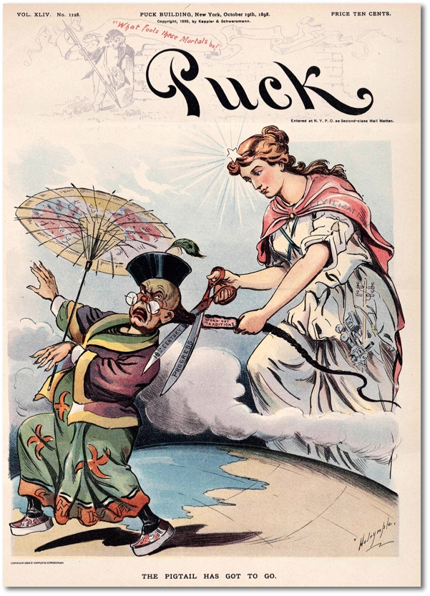
Conclusion
The Chinese Exclusion Act of 1882 marked the shift from essentially open borders to a restrictive immigration policy with closed borders for certain groups.
The 1924 Immigration Act was passed at the height of the restrictive period and lasted into WWII.
Why did the U.S. shift back to a more liberal policy at that time?
Given today’s rising anti-immigrant fervor, is the U.S. entering (or currently in) a new restrictive era?

